Slide 1
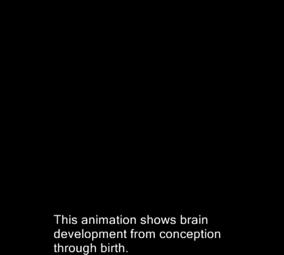
Brain Development
centralia.edu

